Slide 1
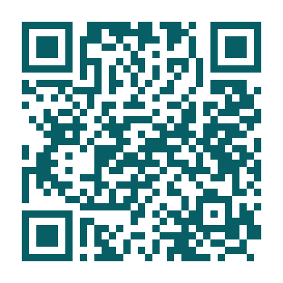
St. Coletta Bus Duty
School pilot proposal • Real-time arrival and dismissal coordination

Slide 2
Why change the workflow?
PM buses can be held while staff verify absent or front-door students.
Five roles need the same current information without losing bus order.
Only nine buses fit safely; each set must clear before the next enters.
Double routes and exceptions require precise, immediate communication.

Slide 3
One shared workflow
1. Start
Choose AM, PM, or Front Door.
2. Identify
Select staff name and position.
3. Act
Work the ordered bus set or student roster.
4. Confirm
Broadcast live status and preserve the record.

Slide 4
The right screen for each job
Runner
Orders buses; marks arrived, loaded, departed.
Board Manager
Confirms board order and walkie relay.
PDA
Accounts for students; closes loaded/unloaded buses.
Front Door + Admin
Updates exceptions; maintains and exports records.

Slide 5
Safety and speed controls
Nine-bus set limit and next-set gate
Real-time student and bus updates across devices
PM present, absent, boarded, and left-through-front status
Double-route taking/not-taking instructions by student
Activity log, timestamps, undo, alerts, and fallback process

Slide 6
Privacy and IT review
Start with sample or de-identified records.
Use only the minimum student information needed for operations.
Keep admin credentials private and sensitive fields restricted.
Before production, verify hosting, encryption, retention, backups, incident response, and FERPA compatibility.

Slide 7
Two-week controlled pilot
Prepare
Approvals, sample data, training, fallback rehearsal.
Week 1
Shadow mode with sample or de-identified data.
Week 2
Limited live use if approved; daily debrief.
Decide
Export, measure, revise, extend, or stop.

Slide 8
Decision requested
Approve a limited pilot with IT/privacy review and the current paper/radio process as backup.
Pilot owner: ____________________
Target dates: ____________________
Support contact: _________________

